Slide 1
Graphene
An IR for Optimized Tensor Computations on GPUs

Slide 2
Abstract
Existing tensor IRs are not expressive enough to represent the complex data-to-thread mappings required by the GPU tensor instructions.
Graphene
a low-level target language for tensor compilers
multi-dimensional data and threads are represented as first-class tensors
tensors are hierarchically decomposable into tiles allowing to represent optimized tensor computations as mappings between data and thread tiles
capable of expressing all optimizations required to achieve the same practical peak performance as existing library implementations
Notes:
在graphene中多维数据和线程都被表示为tensor
tensor分解为一系列的tile的计算操作就表示了data和thread之间的映射关系
Graphene生成的内核媲美了高度调优的库实现的性能

Slide 3
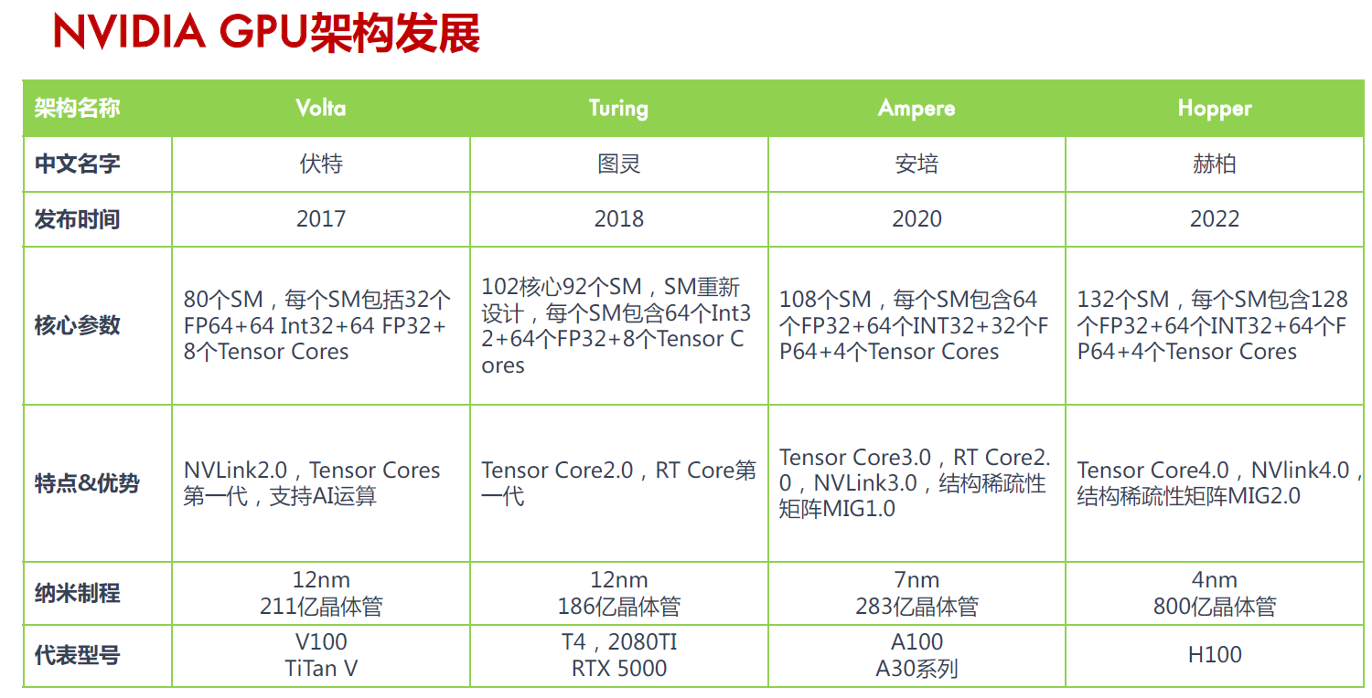
Motivation
the GPU hardware became more tensor-oriented，but the software has not changed
CUDA C++ has no standard abstraction for tensors to represent multi-dimensional data or threads.
expressing optimized tensor computations extremely challenging even for experts
Notes:
从Volta架构引入tensor core开始，GPU硬件层面变得越来越tensor-oriented

Slide 4
Motivation
SOTA tensor IRs like OpenAI Triton, or TensorIR, and deep learning compilers like XLA or TVM
rely on vendor library kernels and leave the challenge of representing optimized tensor programs to the library developers who again use CUDA C++ and PTX
expose the fast PTX instructions as higher-level built-ins operating on tensors (TVM’s tensorize primitive, or MLIR’s gpu dialect), but lack abstractions for some of the most important instructions
expose a high-level surface language to programmers, complex built-in transformation passes (Triton)
Notes:
将 fast PTX instructions 封装到更高阶段的调用，但是由于缺乏复杂 data-to-thread mappings and layout，所以缺失了一些重要的指令
能受pass的组合影响很大，需要较强的经验知识

Slide 5
Contribution
expressive enough to explicitly represent highly optimized GPU code targeting tensor instructions
a novel representation for tensor shapes, layouts and tiles, tensors are decomposable into tiles represented as smaller nested tensors
logical thread groups for representing the GPU compute hierarchy as a tensor of processing elements
decomposable specifications (specs) as an abstraction for collective computations and data movements

Slide 6
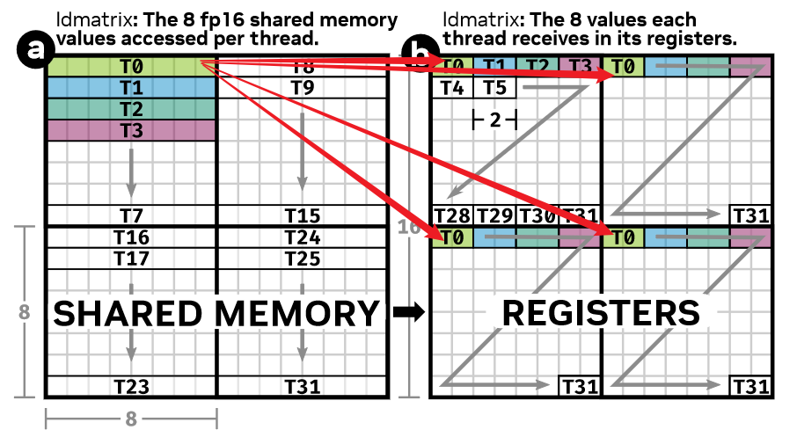
2 OPTIMIZED GPU DATA MOVEMENTS
the ldmatrix instruction : uses a warp (32 threads) to move up to four 8 × 8 matrices from shared memory into the registers of the warp‘s threads
32 个 threads 移动 4 个 8 × 8 矩阵
每 8 个 threads 分配给一个 8 × 8 tile
每个 thread 访问对应 tile 的一行
每个 thread 在每个 tile 中都会接收到 2 个相邻的值(4个 tile, 一共八个值)
图 (a)(b) 中表达的多维映射关系较难在 CUDA 代码中表示

Slide 7
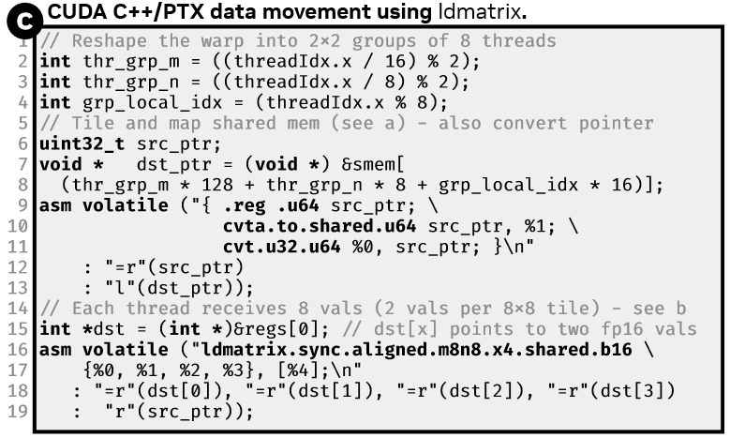
CUDA C++/PTX
define a set of scalar thread index
reshape the warp into 2 × 2 8-thread groups
further cast the access of the shared memory buffer into a valid shared memory pointer (由于CUDA和PTX处理地址的方式)
then call ldmatrix
浪费了很多空间（存储临时变量）和时间（提升为指针）
—> 缺乏表示复杂 date-to-thread mapping 的能力

Slide 8
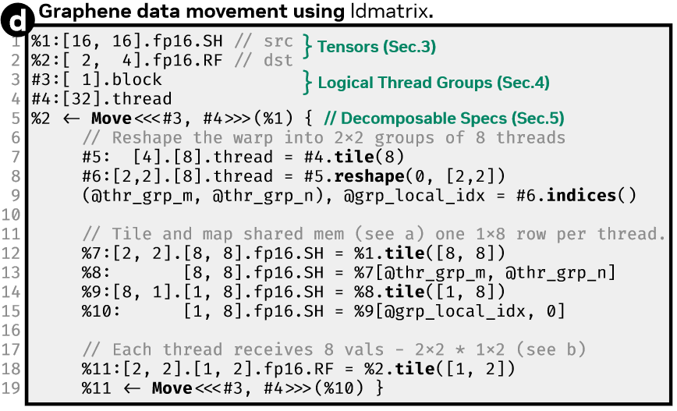
Graphene
declaration : the required data tensors and the available GPU processing elements
data movement : 每个线程将 share memory 上的数据移动到 2 x 4 个 registers 上
对 warp 和 输入数据 进行分解：1个warp被分为4个 logical thread group，每个group 有 8 个 thread，4 个 group 又被 reshape 成 2 x 2 的形状；输入数据被分成 4 个 8 x 8 的矩阵，每个 group 负责一个矩阵，每个 8 x 8 的矩阵又被分为 8 行，每行由一个 thread 负责

Slide 9
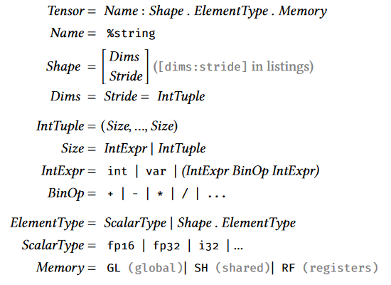
3 THE SHAPE OF TENSORS TO COME
Existing tensor IRs that typically use integer lists for specifying the shapes and strides of tensors cannot express such layouts
Graphene中的tensor： A:[16,16].fp16.SH is actually represented as a row-major tensor A:[(16,16):(16,1)].fp16.SH

Slide 10
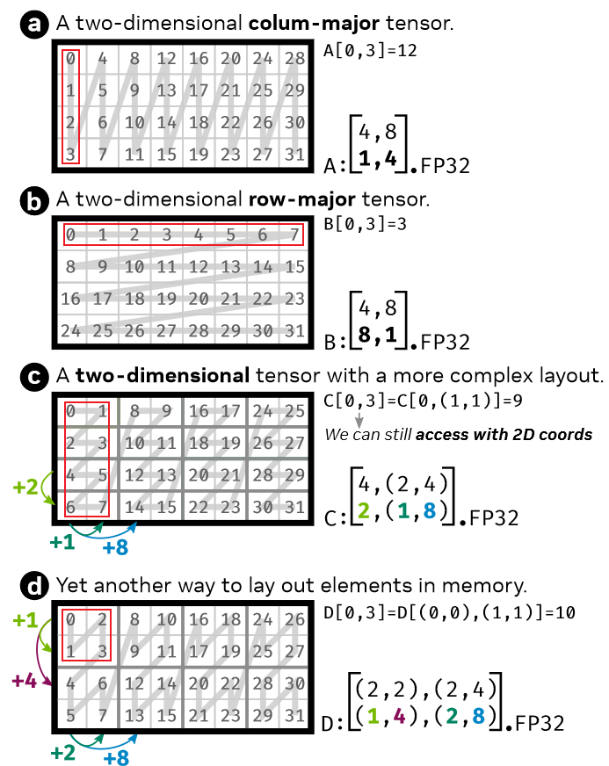
一般而言，optimized kernels要想达到更好的峰值性能往往需要更复杂的layout，以此来适应硬件架构，很难使用整数索引表示
a: 4行，每行首元素间距是1；8列，每列首元素间距是4
b: 4行，每行首元素间距是8；8列，每列首元素间距是1
c: 4行，每行首元素间距是2；8列，两个首元素间距为1的列划分为1组，共4组，每组首元素间距为4
d: 4行，两个首元素间距为2的行划分为1组，共2组，每组首元素间距为8；8列，两个首元素间距为2的列划分为1组，共4组，每组首元素间距为8
很轻易地表示复杂的layout

Slide 11
表达 optimized tensor computations 的关键 ：
multi-dimensional tensors
the multi-layered compute
和 memory hierarchy (global, shared memory and registers)
Graphene’s key abstraction for representing such mappings are tiles

Slide 12
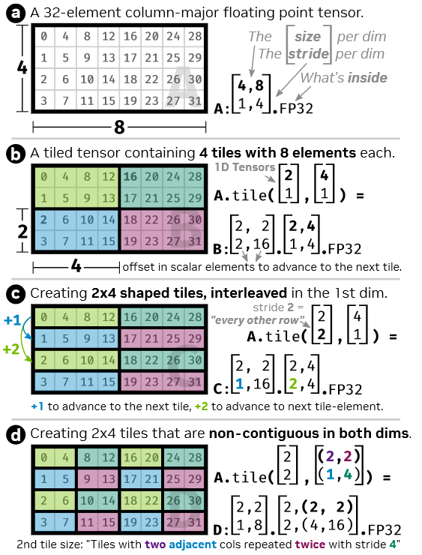
给出一种生成不同 layout 的方法 .tile
b: 第一个维度( [ 2：1 ] )中两个逻辑相邻的元素 和 第二个维度( [ 4：1 ] )中四个逻辑相邻的元素 组成一个tile
c: 第一个维度( [ 2：2 ] )中两个逻辑间距为2的元素 和 第二个维度( [ 4：1 ] )中四个逻辑相邻的元素 组成一个tile
d: 第一个维度( [ 2：2 ] )中两个逻辑间距为2的元素 第二个维度( [ (2, 2) : (1, 4) ] )中两个相邻元素以及两个逻辑间距为4的元素 组成一个tile
正如ldmatrix一样，一些高度优化的GPU tensor computions会使用这样的非连续layout
Notes:
Graphene is capable of representing tensor with parametric (i.e. symbolic) shapes such as [M,N].fp32 (Graphene 也能表示动态shape)
For representing implementations that involve partial tiles, Graphene applies the CuTe approach of over approximating the involved shapes (对于使用partial tiles，即只是用tensor的一部分进行计算，Graphene 使用了类似于 CuTe 中的方法)

Slide 13
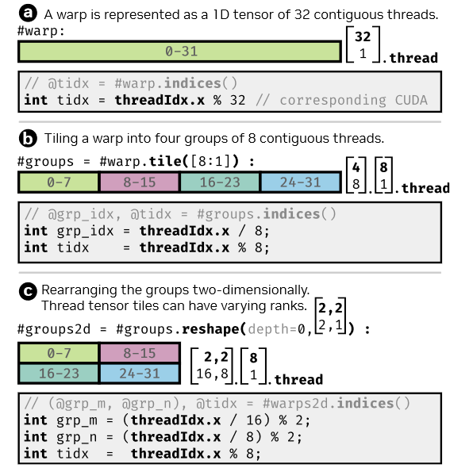
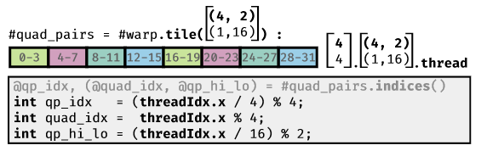
4 LOGICAL THREAD GROUPS
Efficient tensor computations require different arrangements of threads at different points in the kernel
ldmatrix : eight contiguous threads per warp
Tensor Core mma.m8n8k4 : eight specific non-contiguous threads per warp called quad-pairs
Notes:
Ldmatrix: warp中八个连续的threads
Tensorcore mma: warp中特定的不连续的八个threads
% 作为前缀表示data tensor
# 作为前缀表示thread tensor

Slide 14
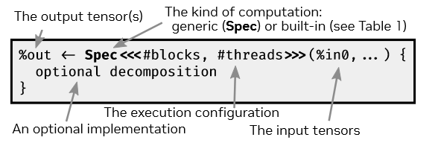
5 SPECIFICATIONS AND DECOMPOSITIONS
How Graphene represents optimized tensor computations using data and thread tensors ?
Spec
input
output
execution configuration (available threads for executing this computation)
Notes:
用spec来表示计算，spec是封装的一个独立的计算块

Slide 15
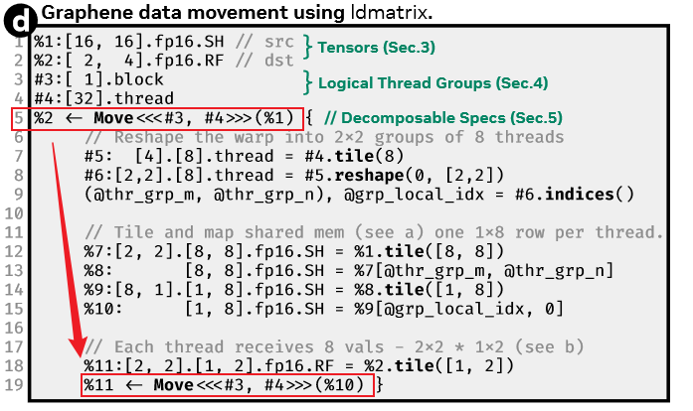
specs (describing the kernel-level computation)
—> fine-grained specs (working on tiles of data and thread tensors)
—> atomic specs (know how to generate code)
第5行声明了一个 warp-level data 从 share memory 移动到 registers 的行为
经过中间代码的对 data 进行 layout 重排布，以及对将 warp 划分为合适的线程组
这样逐步分解为可以表示为 ldmatrix 指令的移动行为
Notes:
首先用 specs 来描述 kernel-level computation，然后分解到更细粒度的 specs(working on tiles of data and thread tensors)，然后到可以指导codegen的atomic specs

Slide 16
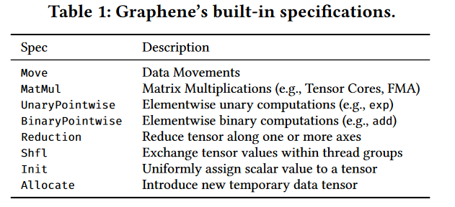
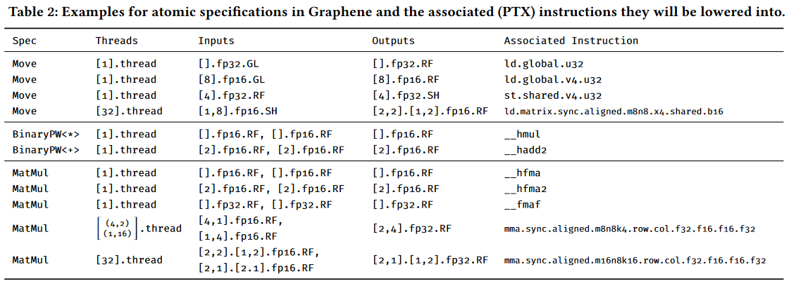
Graphene 中给出了一些预先设定好的 specs，来表示操作
Spec
input
output
execution configuration (available threads for executing this computation)
对应的映射不同的 PTX 指令
Notes:
这些 specs 根据 (input, output, execution configuration) 的不同，也会对应的映射不同的 PTX 指令

Slide 17
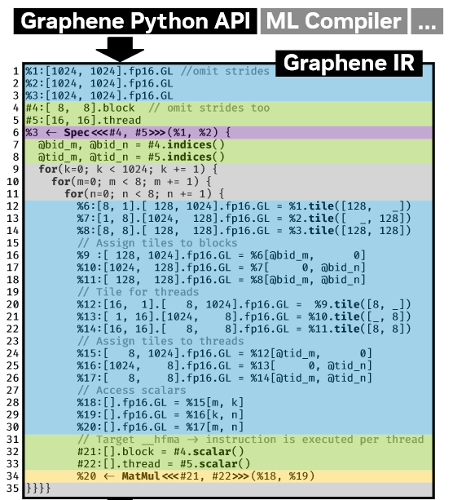
Example: A Simple GEMM Kernel
lines 1-5 : describe the input and output tensors and the available blocks and threads for executing this computation
line 6 : represents the CUDA C++ kernel
lines 9-11 : simple triple-nested for-loop for iterating over the scalar output elements computed per thread
lines 12-18 : tile for threadblocks
lines 20-26 : tile again for threads
line 34 : specify the sequential scalar computation per thread (the spec match the pre-defined atomic hfma spec)
Notes:
使用Python API来生成Graphene IR
line 34 : 指定每个线程的顺序标量计算

Slide 18
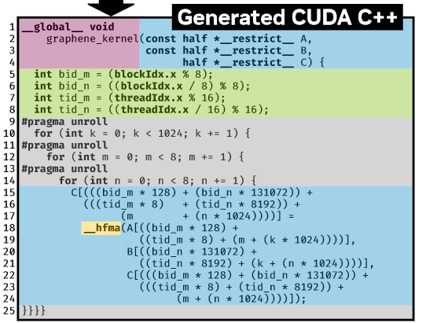
对于需要分解的 spec ：递归地实现
对于 tensor 操作 ：构建AST并将其编译为 thread index 和 buffer access expressions
Notes:
Graphene IR 精确地描述了张量计算的实现，生成CUDA C++

Slide 19
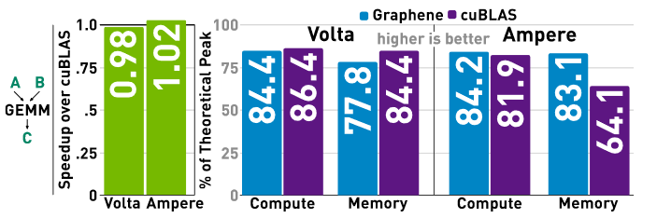
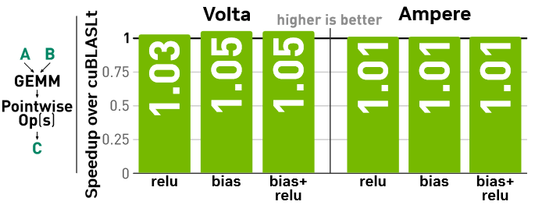
6 EVALUATION
通用性 : 针对不同的GPU架构 (Volta 和 Ampere)
性能 : 与最优秀的库进行对比 (cuBLAS)
Hypothesis A: Graphene can represent kernels that compete with high-performance library implementations.
GEMM : match the performance of cuBLAS on both architectures
GEMM kernels with fused pointwise operations : match the performance of the highly tuned library(cuBLASLt) implementations
Notes:
假设A：Graphene生成的内核 能代表当今GPU上实现最高性能的等效优化
在两种架构上，Graphene生成的内核媲美了高度调优的库实现的性能

Slide 20
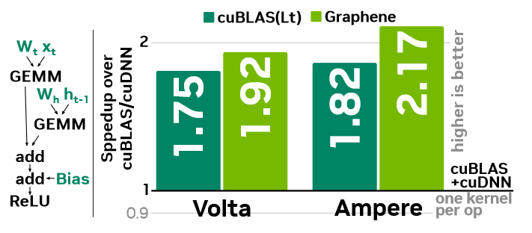
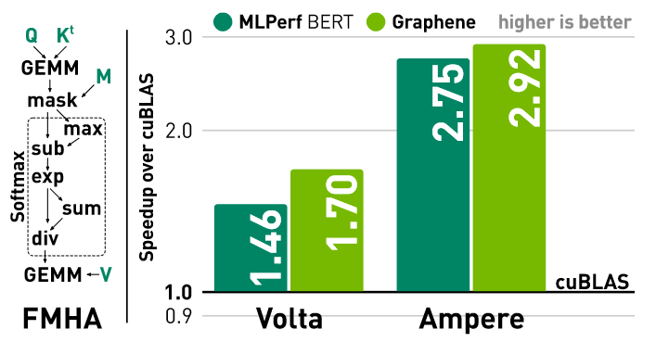
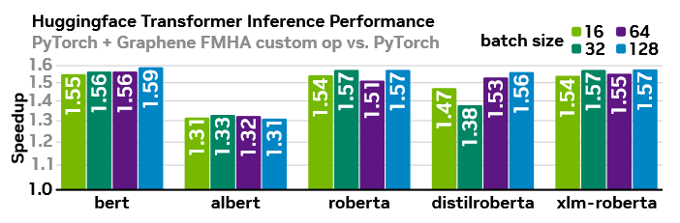
Hypothesis B: Graphene generates competitive fused kernels for important deep learning tensor computations.
LSTM-cell : fuses all nodes into a single kernel, results in significant speedups
Fused Multi-Head Attention (FMHA) 将Graphene生成的Ampere FMHA内核注多个入Huggingface Transformer网络，取得了高达59 %的加速比。(加速比与每个网络中FMHA出现的比例相关)
Notes:
假设B：对于DL任务，Graphene能生成高性能的fused kernel
Fuse所有节点到一个kernel是为了 避免因为计算中间结果而往返于全局内存
与常规的PyTorch推理性能相比，取得了高达59 %的加速比

